Slide 1
Marketplace New Design & User Story
2020.6.12

Slide 2
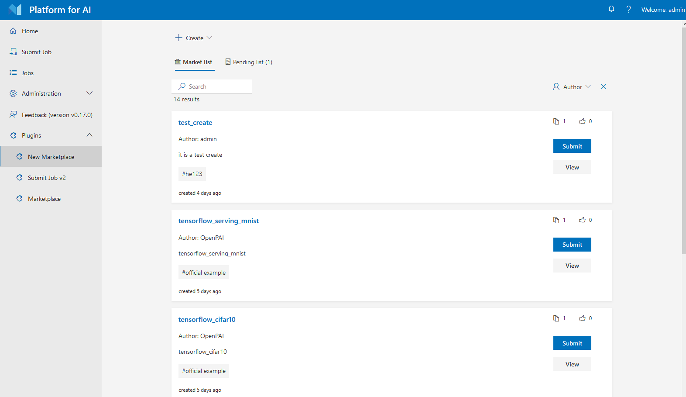
Marketplace 1.0 – Job Template Sharing
Template review (admin only)
Share or create
new template
View & use
template
Notes:
Validate each module config with corresponding schema
Validate globalConfig with all schemas.
Validate each dependency module config with all corresponding schemas.
Allow default value
Only submodule appears in config will be processed

Slide 3
Marketplace 2.0
1. Extensions of platform
Easy data storage and access methods
Create and management docker image
Quick start a debugging environments (virtual machine)
Combined with jupyter notebook service
Provide service hosting for model inference
2. Sharing between users and teams
datasets, model, code, courses, environments, job templates…
Notes:
Validate each module config with corresponding schema
Validate globalConfig with all schemas.
Validate each dependency module config with all corresponding schemas.
Allow default value
Only submodule appears in config will be processed

Slide 4
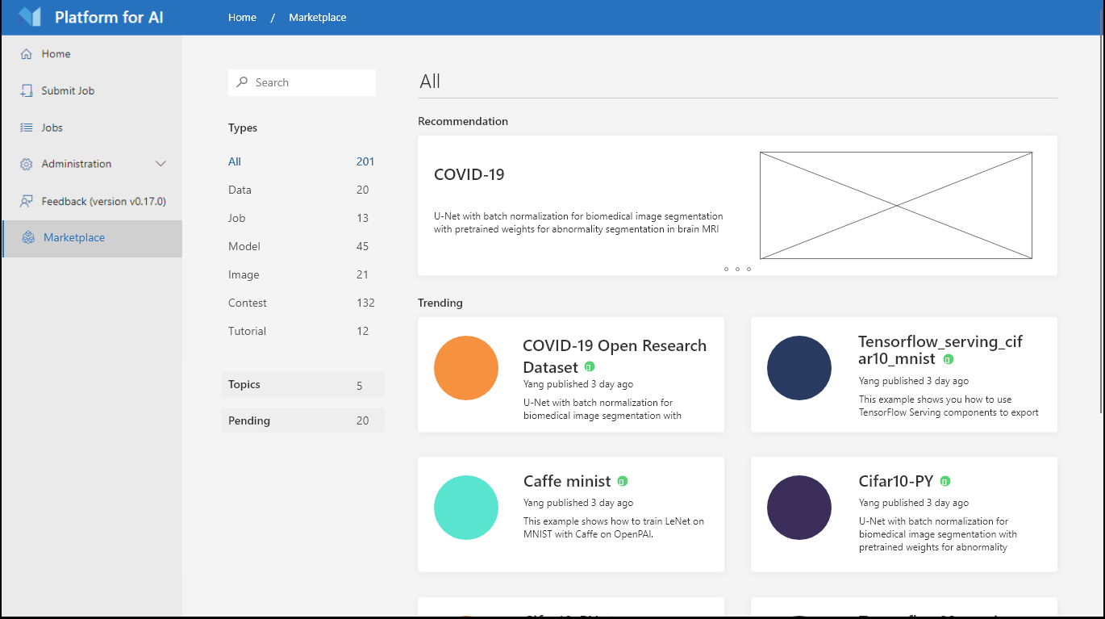
New UI Design
Notes:
Validate each module config with corresponding schema
Validate globalConfig with all schemas.
Validate each dependency module config with all corresponding schemas.
Allow default value
Only submodule appears in config will be processed

Slide 5

New UI Design
Notes:
Validate each module config with corresponding schema
Validate globalConfig with all schemas.
Validate each dependency module config with all corresponding schemas.
Allow default value
Only submodule appears in config will be processed

Slide 6
New Features
1. Data
Provide a shared storage for users to upload their data (NFS, Azure blob)
User could also add their own public data link (cache)
Access in running job: download in previous or use preset interface to access the data
2. Provide an extension for starting a jupyter notebook with prepared environment
User could quick start a jupyter notebook without any config
Easy debug or submit results to specified place
3. Provide an extension for starting a debugging vm
Start a vm with prepared environment, easiest way of debugging for model training
Management of vm for running time and stop
Notes:
Validate each module config with corresponding schema
Validate globalConfig with all schemas.
Validate each dependency module config with all corresponding schemas.
Allow default value
Only submodule appears in config will be processed

Slide 7
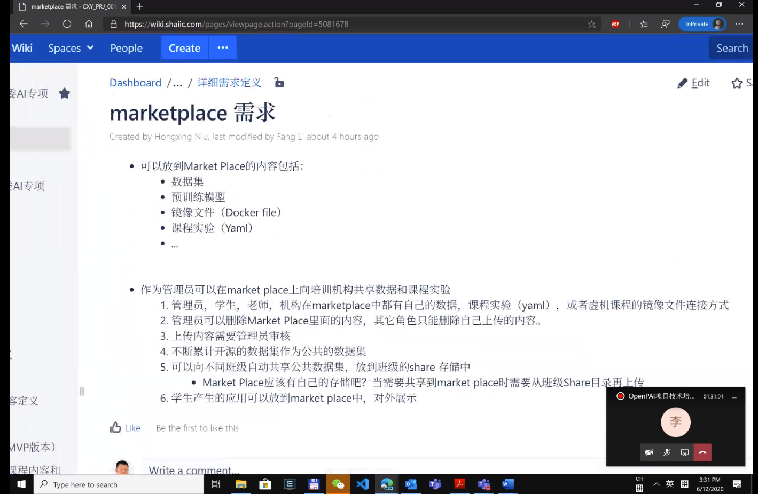
Notes
Notes:
Validate each module config with corresponding schema
Validate globalConfig with all schemas.
Validate each dependency module config with all corresponding schemas.
Allow default value
Only submodule appears in config will be processed

Slide 8
Notes
Data Storage (数据管理接口）
公共展示区 (dashboard)
用户权限： 第三方app token，oauth，描述可见 yaml不可见， group
数据集，预训练模型
Notes:
Validate each module config with corresponding schema
Validate globalConfig with all schemas.
Validate each dependency module config with all corresponding schemas.
Allow default value
Only submodule appears in config will be processed

